Slide 1
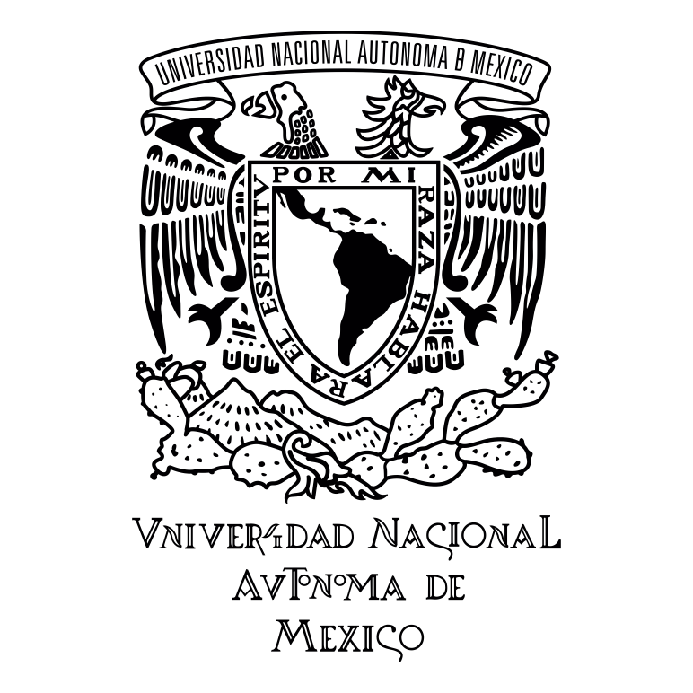
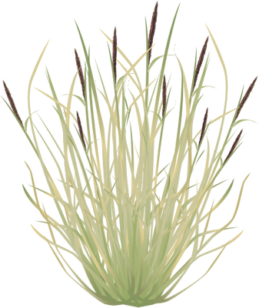
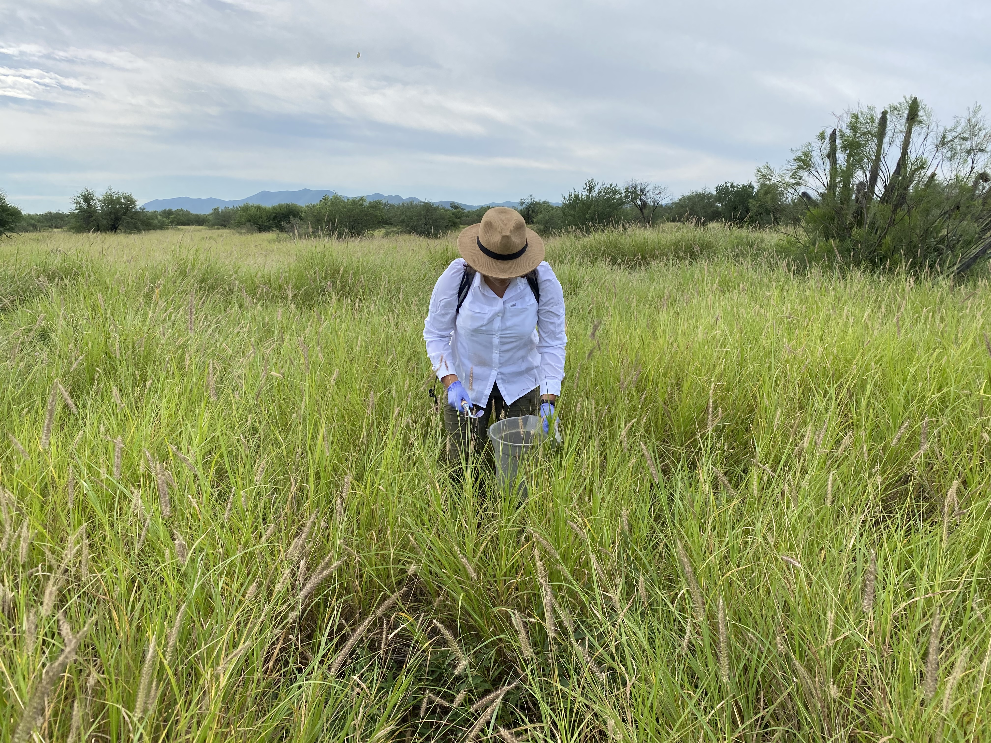
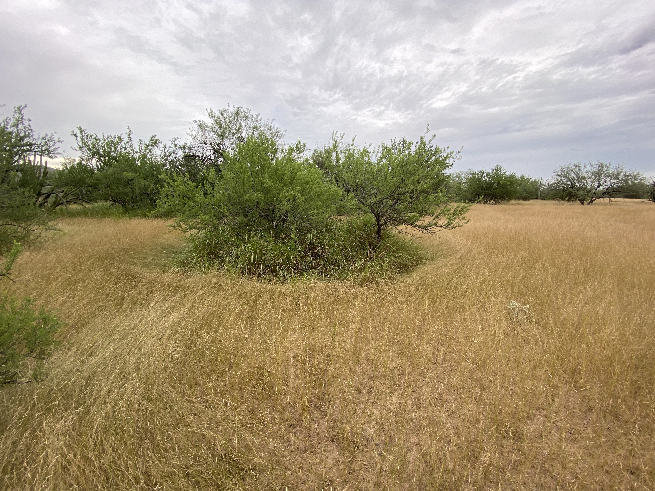



Influence of buffelgrass invasion on the soil microbiome under native trees in the Sonoran Desert
Gabriela Iñigo Gámiz^{1*}, María Touceda-Suárez², Elise S. Gornish¹, Alberto Búrquez³, Angelina Martínez-Yrízar³, Albert Barberán²
¹School of Natural Resources and the Environment, University of Arizona, USA
²Department of Environmental Science, University of Arizona, USA
³Instituto de Ecología, Universidad Nacional Autónoma de México, México
*Corresponding author: gabrielainigo@arizona.edu
Soils under trees where buffelgrass has been induced have larger microbial richness
(except for mesquite trees where richness is large regardless of invasion levels)
Background: Buffelgrass invasion
Buffelgrass (Cenchrus ciliaris L.) is an invasive plant species native to East Africa that was introduced to the Sonoran Desert as cattle forage in the 1930s.
We seek to understand how the influence of buffelgrass on the soil microbiome of three tree species (mesquite, ironwood, palo verde) could play a role in its invasion success in the Sonoran Desert.
We collected soil samples from the understory of trees, located in the core area of buffelgrass invasion in the state of Sonora, México, that had three different invasion levels:
Without buffelgrass
Naturally invaded with buffelgrass
Induced with buffelgrass
Our hypotheses are:
Buffelgrass invasion decreases the soil microbial community diversity and shifts community composition.
Buffelgrass invasion influences the relative abundance of fungal symbiotic (ectomycorrhizal) and antagonistic (pathogens).
Microbial composition under palo verde is different among invasion levels
(under mesquite trees composition is similar)
Relative abundances of fungal guilds are influenced by buffelgrass invasion
Buffelgrass in an induced grassland.
A mesquite tree with buffelgrass below its canopy and surrounded by native grass.
Methods
Soil Samples stored at -80Cº
DNA Extraction
Ilumina Sequencing
Data preparation
Data analysis

